Slide 1







Trends on Emerging Skills
Qiaoyu Huang
2022-01-11

Slide 2



OUTLINE
Executive Summary
Introduction
Methodology
Results
Visualization – Charts
Dashboard
Discussion
Findings & Implications
Conclusion
Appendix

Slide 3

EXECUTIVE SUMMARY
Data gathered from various sources and cleaned successfully
Ensure visualization was simple and understandable
Various data supporting the trend is changing
Many top languages are database will remain important

Slide 4

INTRODUCTION
Result debrief
Programming language trend analysis
Database trend analysis
Dashboard presentation
Data on changing trends for tech
Demographic data

Slide 5

METHODOLOGY
Data Gathering
Data Cleansing / Wrangling
Visual construction
Presentation of information
Observed trends
Suggestions based on the trends

Slide 6
RESULTS
Various shifting trend identified with the skills and services use this year and next
Most dominate language, service, and database will remain to be important, therefore continuing improving on the current popular languages is important
Workplace should welcome new technology, or at least make the effort to understand them

Slide 7
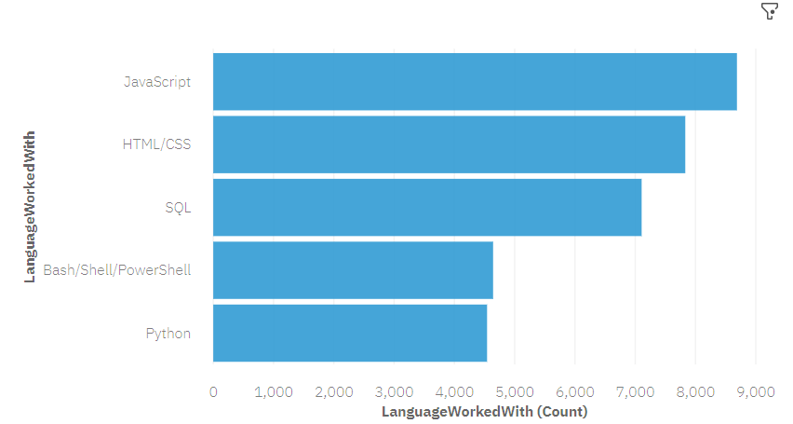
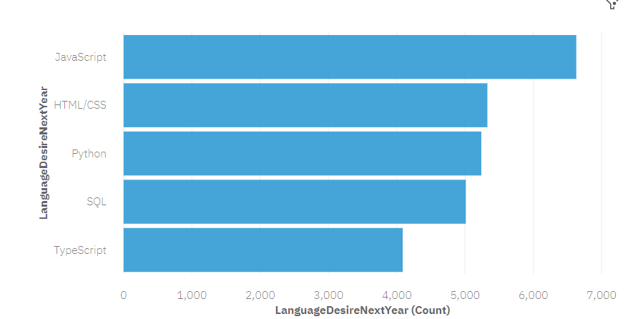
PROGRAMMING LANGUAGE TRENDS
Current Year
Next Year
<Bar chart of top 5 programming languages for the current year goes here.>
< Bar chart of top 5 programming languages for the next year goes here.>

Slide 8
PROGRAMMING LANGUAGE TRENDS - FINDINGS & IMPLICATIONS
Findings
Python is becoming increasing popular
JavaScript remains the most prominent
Implications
Python is suggested for professionals that wish to improve their skills
Should continue expanding on JavaScript knowledge

Slide 9
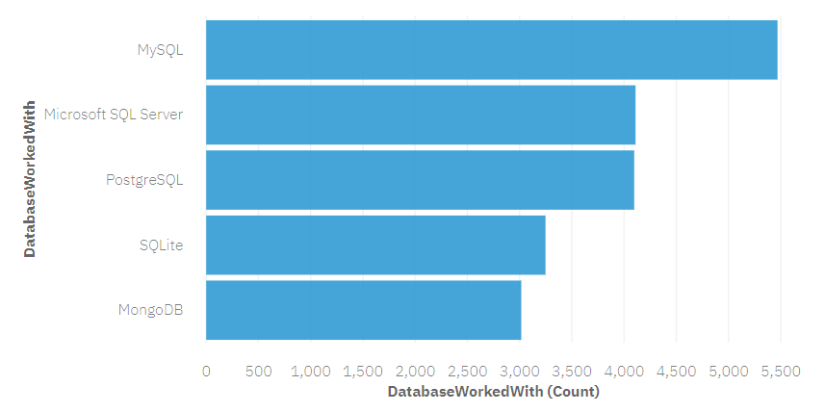
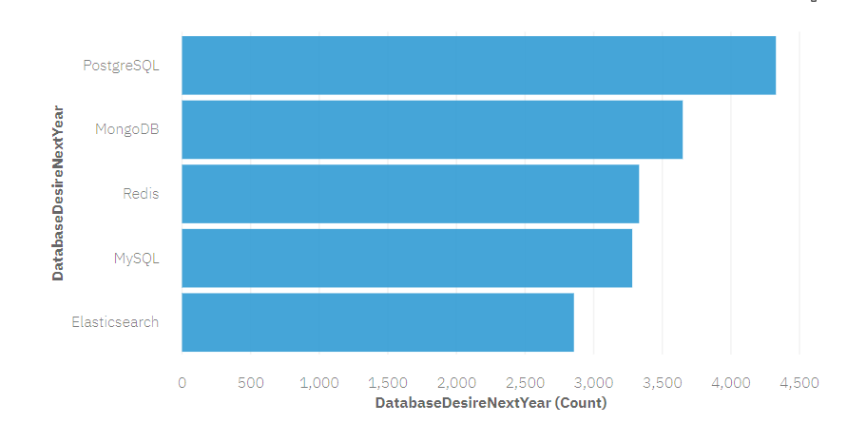
DATABASE TRENDS
Current Year
Next Year
< Bar chart of top 5 databases for the current year goes here >
< Bar chart of top 5 databases for the next year goes here.>

Slide 10
DATABASE TRENDS - FINDINGS & IMPLICATIONS
Findings
PostgreSQL is becoming more popular
Microsoft SQL Server is becoming less prominent
Implications
More people should know about PostgreSQL
Professionals and companies should consider transfer service to other platforms

Slide 11

DASHBOARD
https://dataplatform.cloud.ibm.com/dashboards/c39f51f1-252f-4245-8fbd-f64233c1f261/view/7829a30725e33c9757d1bde40798790f7b652555b5bb870484d37b490f657397f36e1494c87b4352dd125035f3eb410d9a

Slide 12
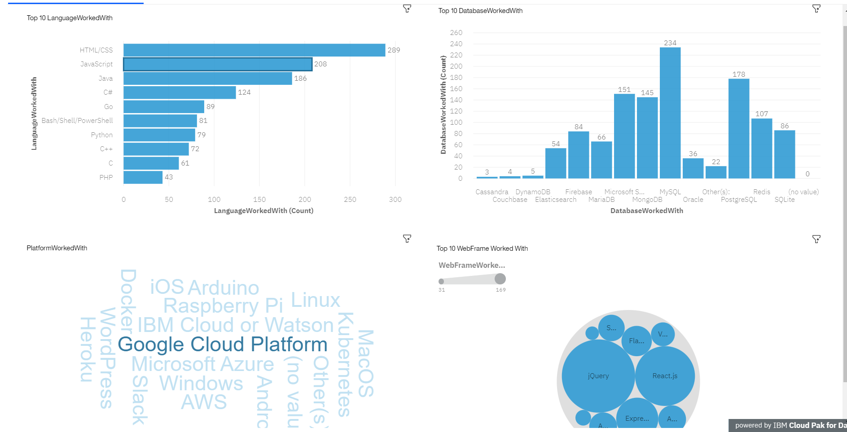
DASHBOARD TAB 1
Screenshot of dashboard tab 1 goes here

Slide 13
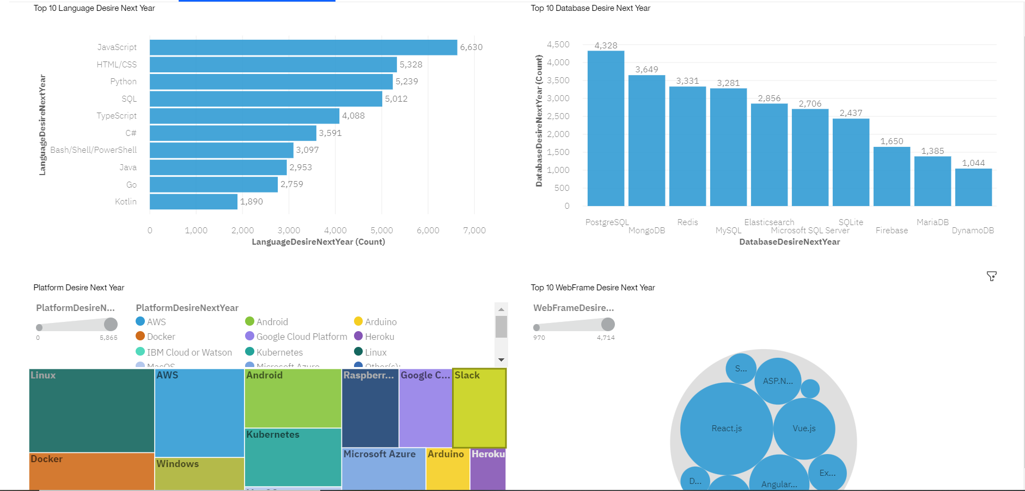
DASHBOARD TAB 2
Screenshot of dashboard tab 2 goes here

Slide 14
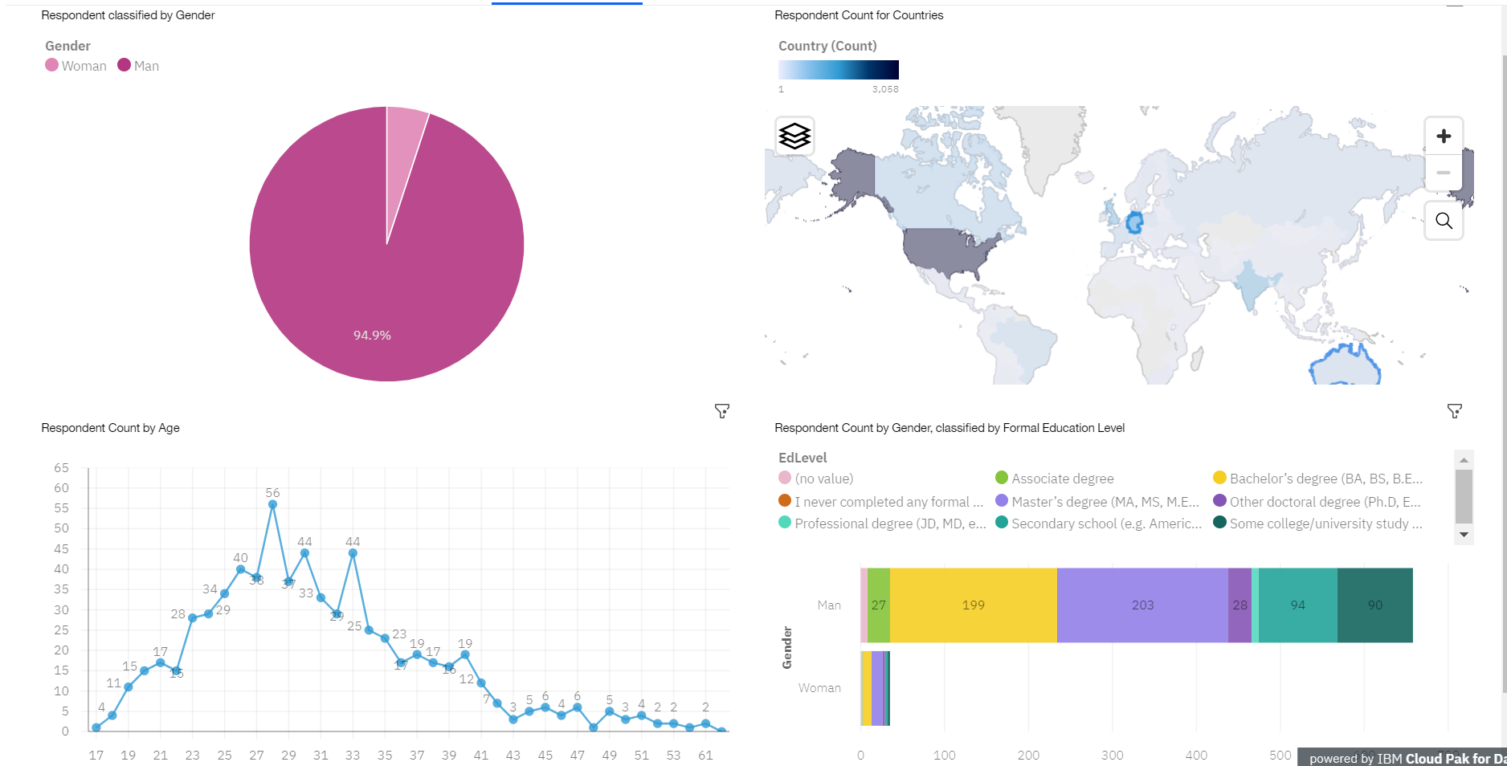
DASHBOARD TAB 3
Screenshot of dashboard tab 3 goes here

Slide 15
DISCUSSION
How is the trend of the most desired platforms, languages, and service changing?
Why should we care about this?
What are the trends on demographics?

Slide 16
OVERALL FINDINGS & IMPLICATIONS
Findings
JavaScript is in high demand as a desired language next year
PostgreSQL is in high demand as a desired database next year
Industry highly dominated by male
Implications
The use of JavaScript overtakes that of HTML, thus suggesting people to learn it first
Suggesting users to be familiar with PostgreSQL
Create future opportunity to allow more female in the workforce

Slide 17

CONCLUSION
Data gathered from various sources and cleaned successfully
Ensure visualization was simple and understandable
Various data supporting the trend is changing
Many top languages are database will remain important
Professionals should continue analyze trends and determined to enrich their career path

Slide 18
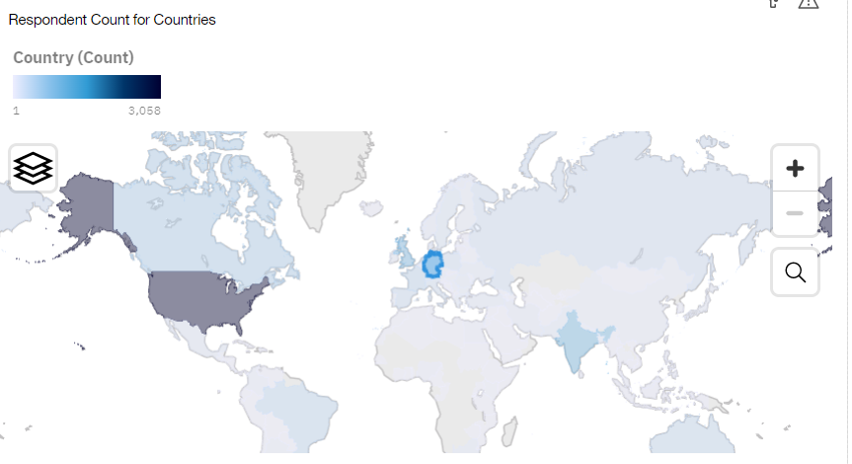

APPENDIX
Include any relevant additional charts, or tables that you may have created during the analysis phase.

Slide 19
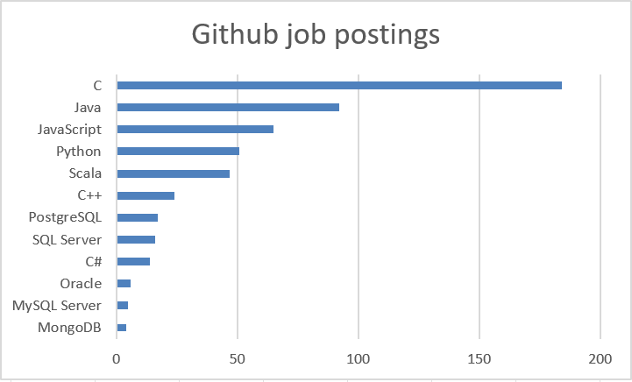
GITHUB JOB POSTINGS

Slide 20
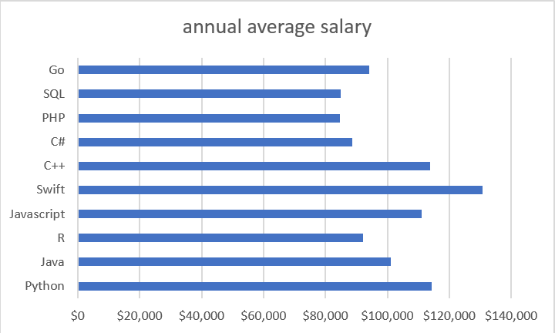
POPULAR LANGUAGES

